Slide 1
Roller Press Hydro Pneumatic Spring Calculation Tool
Roller Press Hydro Pneumatic Spring Calculation To, CM / EPT / GT, 2015-02-05

Slide 2
Agenda
Intension of the Spread Sheet
3
Spread Sheet Structure
4
Spread Sheet Structure – Roller Press Characteristics
5
Spread Sheet Structure – Roller Press Data
6
Spread Sheet Structure – Calculations
7
Spread Sheet Structure – Graphical Visualisation
8
Interpretation
9
Question and Answers…..
10
Roller Press Hydro Pneumatic Spring Calculation To, CM / EPT / GT, 2015-02-05

Slide 3
Intension of the Spread Sheet
The spread sheet should be used for the following tasks:
Check the hydraulic system accumulator settings according operation conditions
Check “grinding bed” comminution pressure distribution according applied
      Accumulator setting
      “Zero” gap adjustment
      Starting pressure
Check maximum comminution pressure applied
Roller Press Hydro Pneumatic Spring Calculation To, CM / EPT / GT, 2015-02-05

Slide 4
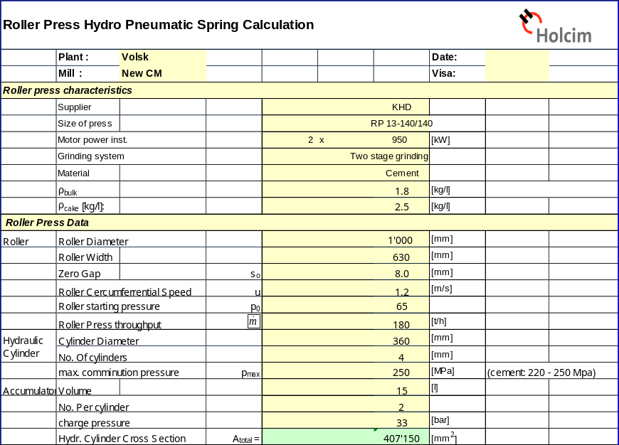
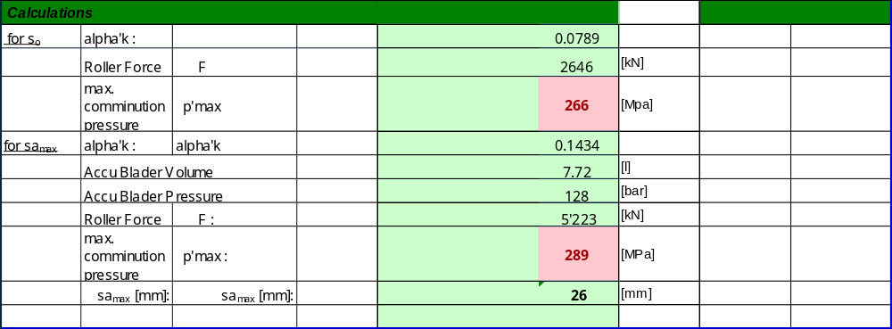
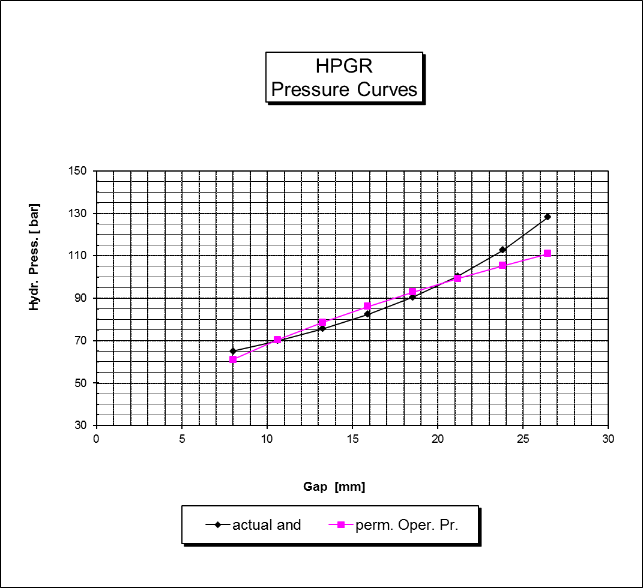
Spread Sheet Structure
Input Values in “Yellow”
Calculated Values in “Green”
Graphical Explanation of the Results
Roller Press Hydro Pneumatic Spring Calculation To, CM / EPT / GT, 2015-02-05

Slide 5
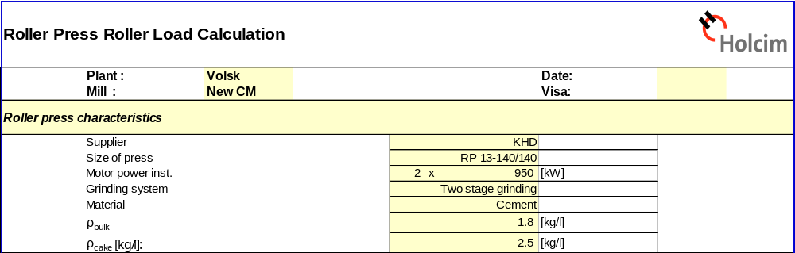
Spread Sheet Structure – Roller Press Characteristics
Indicate always plant, Date and who filled out the sheet
ρ_{bulk}… Bulk density of roller press feed material. Determined by Laboratory standard method
ρ_{cake}…Slab density, carefully determined by Laboratory in beaker glass with oil (weight, volume determination)
Roller Press Hydro Pneumatic Spring Calculation To, CM / EPT / GT, 2015-02-05

Slide 6
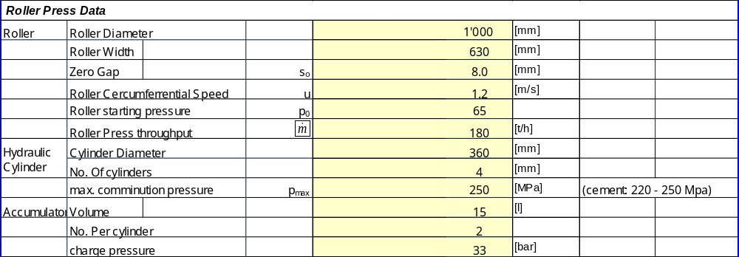
Spread Sheet Structure – Roller Press Data
Add basic roller data, hydraulic cylinder and accumulator data
Roller Press Hydro Pneumatic Spring Calculation To, CM / EPT / GT, 2015-02-05

Slide 7
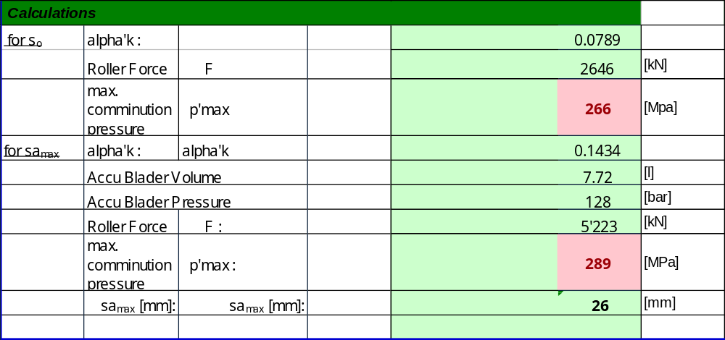
Spread Sheet Structure – Calculations
Maximum comminution pressure in roller gap is calculated for start and operation conditions (s₀ and sa_{max})
Sa_{max}…is calculated according roller speed, throughput and slab density
Roller Press Hydro Pneumatic Spring Calculation To, CM / EPT / GT, 2015-02-05

Slide 8
Spread Sheet Structure – Graphical Visualisation
Maximum permissible pressure in gap
Actual pressure in gap
Roller Press Hydro Pneumatic Spring Calculation To, CM / EPT / GT, 2015-02-05

Slide 9
Interpretation
The pink curve shows the maximum permissible pressure in the grinding gap based on the roller press settings for max. pressure during operation (220 – 250 Mpa)
The black curve shows the actual pressure situation based on the settings
      “zero” gap
      Accumulator volume and pressure
      Starting pressure
Most important and influencing factors are the densities for roller press feed and slab!
Roller Press Hydro Pneumatic Spring Calculation To, CM / EPT / GT, 2015-02-05

Slide 10

Question and Answers…..
Roller Press Hydro Pneumatic Spring Calculation To, CM / EPT / GT, 2015-02-05

